Slide 1
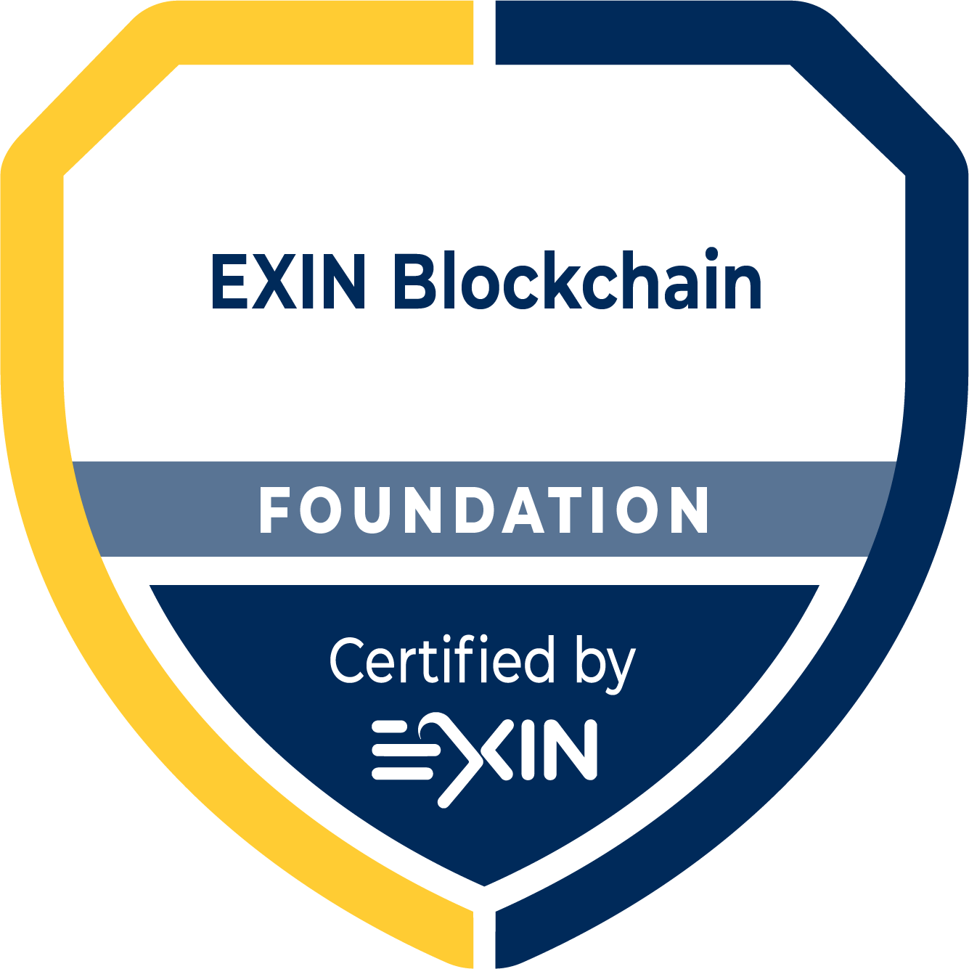
Basic Training Material 202110

Slide 2
Copyright © EXIN Holding B.V. 2021. All rights reserved.
EXIN® is a registered trademark.
No part of this publication may be reproduced, stored, utilized or transmitted in any form or by any means, electronic, mechanical, or otherwise, without the prior written permission from EXIN.

Slide 3
Welcome to the Basic Training Material (BTM)
These slides contain basic presentation material to prepare students for the EXIN Blockchain Foundation and Essentials examinations. They may be used as a basis for an accredited training.
The BTM refers to all exam specifications and basic concepts of this module.
Some trainer notes may be included.
A good training requires examples of practical experience, deepening of exam specifications and basic concepts, exercises, elaborating subjects of special interest to the audience.
In case of a minimal training duration, candidates are expected to study the literature. (compare training duration with study load in Preparation Guide)
The order in which the subjects are presented, follow the order of the exam specifications.
This BTM is not a complete set of courseware. In order to become accredited you will need to enhance and enrich this material.
When using this BTM, your organization will still need to go through the normal accreditation procedure at EXIN. You can find the accreditation requirements in the Accreditation Manual.
This BTM is a service for training providers, no rights can be derived from it.
Please note that this BTM cannot be sold commercially. ATO’s are allowed to use these materials for the sole purpose of developing their own full courseware to be used in EXIN accredited training. They may not create other commercial products and services based on this file without permission from EXIN. When parts of it are used in another context the source must be referenced and the EXIN copyright statement added.

Slide 4
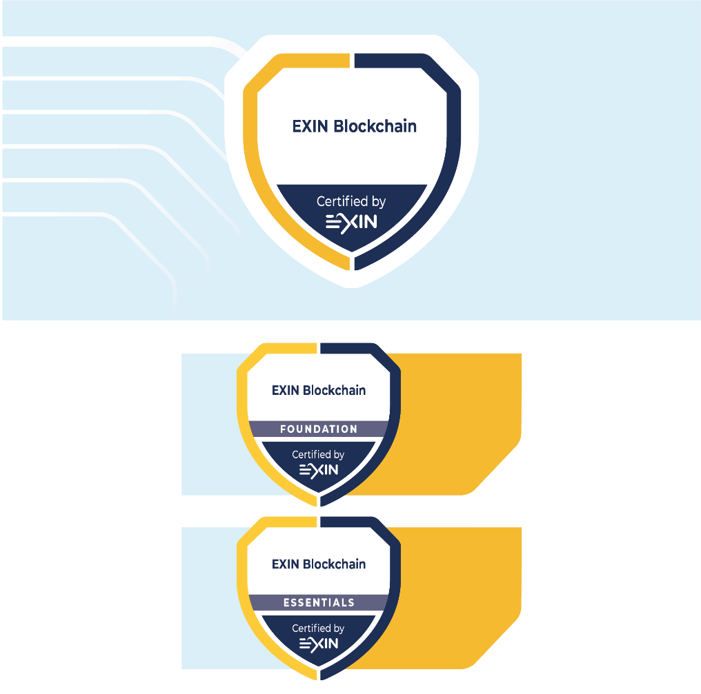
Program Overview
Notes:
Modules
EXIN Blockchain has two certifications:
EXIN Blockchain Essentials
EXIN Blockchain Foundation

Slide 5
Training schedule
Blockchain Basics
Blockchain Challenges
Applications of a Blockchain
Blockchain Innovations

Slide 6
Course Objectives and Target Group
EXIN Blockchain Foundation is a certification that validates a professional’s knowledge about:
blockchain basics;
blockchain challenges;
applications of a blockchain;
blockchain innovations.
This certification is tailored to professionals in both business and IT who have, or aim to have, a professional role in blockchain as a cryptographic and smart contract solution.

Slide 7
Requirements for Certification
Successful completion of the EXIN Blockchain Foundation or Essentials exam.

Slide 8
Basic Concepts
The list of Basic Concepts in the student notes below will be considered understood for the exam
The student is advised to research and understand the concepts
Notes:
Basic concepts:
asymmetric encryption
artificial intelligence (AI)
strong AI / general AI
weak AI / narrow AI
block header
blockchain
hybrid blockchain
private blockchain
public blockchain
connected device
consensus algorithm
delegated proof of stake (DPoS)
proof of authority (PoA)
proof of burn (PoB)
proof of capacity (PoC)
proof of elapsed time (PoET)
proof of space (PoSpace)
proof of stake (PoS)
proof of work (PoW)
cryptocurrency
cryptography
decentralized application (DApp)
decentralized autonomous organization (DAO)
decentralized exchange
decentralized identity
decentralized marketplace
digital fiat currency / central bank digital currency (CBDC)
distributed ledger technology (DLT)
e-mail spam
externally owned account (EOA)
hacking
hash
intellectual property rights (IP)
internet of things (IoT)
lean governments
ledger
mining
near-field communication (NFC)
node
full node
lightweight node / client
nonce
opcode
peer-to-peer network (P2P)
private key
public key
public witness
radio frequency identification (RFID)
second generation tokens
segregated witness (SegWit)
self-sovereign identity
smart contract
spoofing
stable coin
supply chain
token
trusted execution environment (TEE)
virtual machine (VM)
vulnerabilities

Slide 9
Exam Format EXIN Blockchain Foundation
Examination type: | Multiple-choice Questions
Number of questions: | 40
Pass mark: | 65% (26/40 questions)
Open book/notes: | No
Electronic equipment/aides permitted: | No
Exam duration: | 60 minutes
The Rules and Regulations for EXIN’s examinations apply to this exam.

Slide 10
Exam Format EXIN Blockchain Essentials
Examination type: | Multiple-choice Questions
Number of questions: | 20
Pass mark: | 65% (13/20 questions)
Open book/notes: | No
Electronic equipment/aides permitted: | No
Exam duration: | 30 minutes
The Rules and Regulations for EXIN’s examinations apply to this exam.

Slide 11
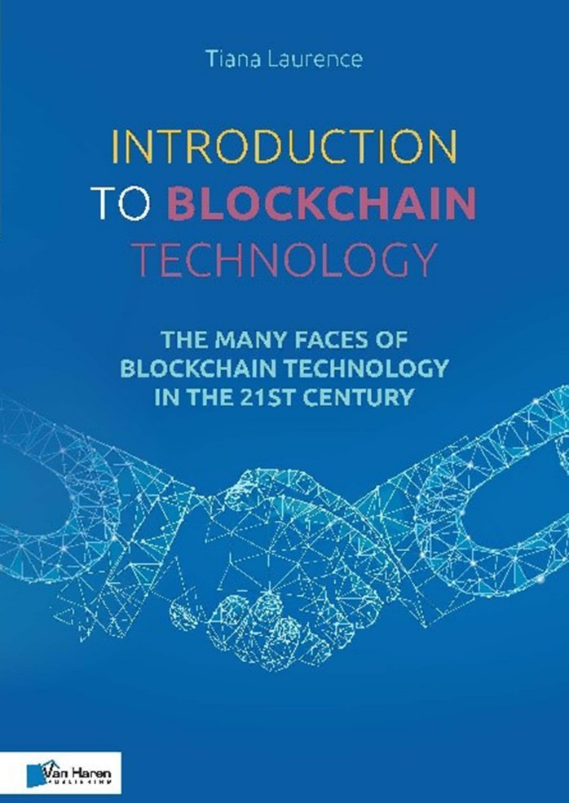
Exam Literature
Tiana Laurence
Introduction to Blockchain Technology – The many faces of blockchain technology in the 21st century
Van Haren Publishing (November 2019)
ISBN: 978 94 018 0499 8 (hardcopy)
ISBN: 978 94 018 0501 8 (eBook)
ISBN: 978 94 018 0504 9 (ePub)

Slide 12
1. Blockchain Basics

Slide 13
1.1 Blockchain Technology
Notes:
Literature: Introduction to Blockchain Technology; Chapter 1 and 2

Slide 14




1.1.1 Explain how a blockchain works
What is blockchain?
A peer-to-peer distributed time-stamp server that holds a record of all transactions that have ever occurred on that network.
validate
Notes:
Literature: Introduction to Blockchain Technology; Chapter 1: Section 1.1 Key blockchain concepts

Slide 15
1.1.1 Explain how a blockchain works
Blockchain is the underlying technology of Bitcoin: a peer-to-peer electronic cash system
Blockchain records and secures transactions in “blocks” that are “chained” together
Once entries have been recorded in a block and chained to the previous block they are secured against changes via a consensus mechanism
Bitcoin uses Proof-of-Work (PoW) as consensus mechanism. A record that cannot be changed without redoing the Proof-of-Work.
Notes:
Literature: Introduction to Blockchain Technology; Chapter 1: Section 1.1 Key blockchain concepts
Satoshi Nakamoto was proposing a solution to the double-spending problem in a peer-to-peer network.
The network timestamps transactions by hashing them into an ongoing chain of hash-based proof-of-work, forming a record that cannot be changed without redoing the proof-of-work.

Slide 16

1.1.2 Explain what a node is
validate
A computer connected to a blockchain network
Runs the blockchain software for the network and keeps the network healthy by engaging in the transfer of information across the network to other nodes
Anyone can run a node on a public network
Not all nodes are the same
Notes:
Literature: Introduction to Blockchain Technology; Chapter 1: Section 1.1 Key blockchain concepts

Slide 17
1.1.3 Identify the role of a node in a network
Full node
Has a complete and up-to-date history of the network’s transactions
Can independently build and verify any transaction
Part of consensus system
Lightweight node or client
Lightweight nodes verify transactions by piggybacking on the work of full nodes.
Only download the headers of all blocks
Miner
A full node that also aggregates validated transactions to a candidate bock
Miners compete to win the right to create a new complete block by solving a complex mathematical problem (proof-of-work)
When the miner succeeds in finding the solution first his or her candidate block becomes a new valid block
Notes:
Literature: Introduction to Blockchain Technology; Chapter 1: Section 1.1 Key blockchain concepts
There are several classifications of nodes depending on the level of participation and the type of blockchain network.

Slide 18
1.1.4 Explain what tokens are
Blockchain enables the issuance of tokens
Tokens can act as a bearer instrument that can be owned
Tokens can represent assets, currency or access rights
Tokens can be used to transfer value between two parties
Notes:
Literature: Introduction to Blockchain Technology; Chapter 1: Section 1.1 Key blockchain concepts

Slide 19
1.1.5 Differentiate between public, private and hybrid blockchains
There are 3 main types of blockchains
Public blockchains
anyone can view all transactions
anyone can add transactions to the network
Private blockchains
only trusted parties can operate the blockchain
identity on network is linked to real identity
Hybrids
control who can participate and at what level
for example: only certain trusted parties can add transactions to the network, but anyone can view the transactions
Notes:
Literature: Introduction to Blockchain Technology; Chapter 1: Section 1.1 Key blockchain concepts
There are three main types of blockchains: public blockchains, private blockchains and hybrids.

Slide 20
1.1.5 Differentiate between public, private and hybrid blockchains
vote
vote
vote
vote
vote
vote
vote
vote
vote
vote
Public: no access restrictions
Hybrid: combination
vote
Private: permissioned
Notes:
Literature: Introduction to Blockchain Technology; Chapter 1: Section 1.1 Key blockchain concepts

Slide 21
1.2 Additional Blockchain Elements
Notes:
Literature: Introduction to Blockchain Technology; Chapter 1 and 2

Slide 22
1.2.1 Explain how cryptography is used in a blockchain
It ensures the encryption of data.
Ancient Greeks and Romans used it to send secret messages.
Blockchains use asymmetric encryption, known as public-key cryptography, to secure the transfer of cryptocurrency from one address to another.
Pair of keys: public key (to send) and a private key (to decode)
Notes:
Literature: Introduction to Blockchain Technology; Chapter 2: Section 2.1 Cryptography

Slide 23
1.2.2 Explain how private and public keys are used in a blockchain
Allows a sender to transfer cryptocurrency to a recipient without someone else interfering.
As long as the sender has the public key of the recipient, cryptocurrency can be transferred.
If a message is encrypted, such as the transfer of cryptocurrency, with a private key, it can only be decrypted by its matching public key.
So, when cryptocurrency is sent to a new public address, only the recipient can decode it, and everyone can see that the sender had the right to transfer cryptocurrency.
Private keys are used to digitally sign transactions and generate public keys
Public keys are used as identity, to proof that the transaction is signed, and the sender is the owner of a token
Notes:
Literature: Introduction to Blockchain Technology; Chapter 2: Section 2.1 Cryptography

Slide 24
1.2.3 Explain how hashes are used in a blockchain
By using hashes, blockchains ensure that records are not corrupted
A hash is similar to symmetric encryption; the data itself creates a fixed length key via a one-way mathematical proof; the data is the key.
A hashing algorithm is used to take a data input of any size and produce a fixed length string.
The fixed length string is the hash and acts as a “signature” or “fingerprint” for the data input.
Hash pointers are used to point to where specific information is stored
Blockchain uses a structure of hash pointers (Merkle Trees) to chain blocks
Notes:
Literature: Introduction to Blockchain Technology; Chapter 2: Section 2.2 What is a hash?

Slide 25
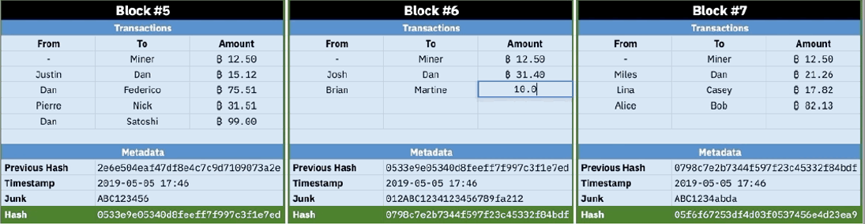
1.2.3 Explain how hashes are used in a blockchain
A hash function is a mathematical function that converts an input value of any size into a compressed numerical number value of a fixed size. Each time the input changes, the hash outcome is different.
Notes:
Literature: Introduction to Blockchain Technology; Chapter 2: Section 2.2 What is a hash?

Slide 26
1.2.4 Explain the purpose ledgers have in a blockchain
Ledgers, the records of economic transactions, are even older technology than encryption.
A transaction is when two parties exchange something and it is recorded in a ledger.
Cryptocurrencies have value, because they can be exchanged between individuals.
Owning cryptocurrency means that you possess a private key that allows you to send it to another public address.
The blockchain secures the proof of exchange, and the blockchain’s consensus algorithm enforces the transfer rules.
Notes:
Literature: Introduction to Blockchain Technology; Chapter 2: Section 2.3 Ledgers

Slide 27
1.2.5 Explain the role mining has in a blockchain
The purpose of mining is to secure the blockchain history.
Traditional currencies are controlled by governments and their central banks.
Cryptocurrency is very different. The algorithm is, or rather the rules that govern the blockchain are, in charge of the creation of new cryptocurrency.
The algorithm facilitates the role of a central bank by either rewarding miners with new cryptocurrency or restricting the issuance of new coins when the competition is high.
Miners compete to win the right to create a new complete block by solving a complex mathematical problem (proof-of-work).
When the miner succeeds in finding the solution first his or her candidate block becomes a new valid block.
Miners are rewarded with tokens for each block they mine and for the transactions in that block.
Notes:
Literature: Introduction to Blockchain Technology; Chapter 2: Section 2.4 The public witness and Chapter 3: Section 3.1 Proof of Work

Slide 28
1.3 Structure of a Blockchain Network
Notes:
Literature: Introduction to Blockchain Technology; Chapter 3

Slide 29
1.3.1 Recognize the types of consensus algorithms from a description
The term “consensus” refers to this ability of a community to collectively agree upon decisions that impact the accuracy and permanence of a given blockchain.
Consensus mechanisms are architectural decisions and tools designed to prevent falsified transactions from occurring on the network. The general principle is to discourage lying by making it more profitable to tell the truth.
A consensus algorithm is a code that governs how a blockchain operates.
It sets the rules that all participants must follow to process transactions.
Consensus algorithms create a network structure and process that allows a group of independent systems to agree on a single version of the truth.
Notes:
Literature: Introduction to Blockchain Technology; Chapter 3 Introduction

Slide 30
1.3.1 Recognize the types of consensus algorithms from a description
Consensus algorithms are foundation of all blockchains
Proof of Work (PoW)
Proof of Stake (PoS)
Delegated Proof of Stake (DPoS)
Proof of Authority (PoA)
Proof of Elapsed Time (PoET)
Proof of Capacity (PoC) and Proof of Space (PoSpace)
Proof of Burn (PoB) and Hyperledger Fabric
Notes:
Literature: Introduction to Blockchain Technology; Chapter 3: Sections 3.1 – 3.8
Consensus algorithms are not unique to blockchain technology, but they are the foundation of all blockchains. They are the set of rules that govern how each blockchain functions.
It is essential to understand the different common blockchain network structures and the consensus algorithms that dictate their structure. Understanding these structures will empower you to make informed design decisions when building applications and processing transactions. In this section, you will uncover many of the most significant consensus rules that govern how blockchains work. You will discover how these algorithms impact the functionality and, by extension, the best use you can obtain from blockchains that utilize this type of consensus algorithm.

Slide 31
1.3.2 Identify advantages and disadvantages of different consensus algorithms
Algorithm | Advantage | Disadvantage
Proof of Work | Tested since 2009 | Slow, expensive, susceptible to centralization
Proof of Stake | Energy efficient | Susceptible to centralization and censorship
Delegated Proof of Stake | Fast | Prone to corruption
Proof of Authority | Fast | Centralized
Proof of Elapsed Time | Scalable | Needs specialized hardware
Proof of Capacity and Proof of Space | Environment friendly | New, not tested
Proof of Burn and Hyperledger Fabric | Cheap | Limited functionality
Notes:
Literature: Introduction to Blockchain Technology; Chapter 3: Sections 3.1 – 3.8

Slide 32
2. Blockchain challenges

Slide 33
2.1 Challenges for a Blockchain
Notes:
Literature: Introduction to Blockchain Technology; Chapter 2, 4 and 10

Slide 34
2.1.1 Identify blockchain vulnerabilities
Both private and public blockchains can be manipulated and trusting them blindly may well lead to disaster.
There are three key vulnerabilities to blockchains and distributed ledgers.
Smart contract vulnerabilities
Code can contain vulnerabilities and can be executed in unexpected ways. There are examples where faulty smart contract code resulted in the loss of millions of tokens.
Centralized public networks Proof of Work (PoW)
PoW public blockchains are only as strong as they are decentralized.
Centralized private networks
Centralized private networks usually don’t have cryptocurrency, which makes them less interesting for hackers. They also have less resources for example for bug finding.
Notes:
Literature: Introduction to Blockchain Technology; Chapter 10: Section 10.1 Blockchain vulnerabilities

Slide 35
2.1.2 Identify the risks community fractures and feuds pose to a blockchain
Narcissism of small differences: communities with adjoining territories and close relationships are more likely to fight.
The rifts in the communities go all the way down to the code.
Notes:
Literature: Introduction to Blockchain Technology; Chapter 10: Section 10.2 Community fractures and feuds

Slide 36
2.1.3 Identify the risks fraud and scams pose to a blockchain
Old crimes unfolding in new ways
Advanced fee schemes - A fraudster convinces you to pay money for something in anticipation of receiving something of greater value at a later time. In the end, you as the victim receive nothing.
Identity theft and credit card fraud - A fraudster steals your credit card and uses it.
Internet and device hacking - Tokens and cryptocurrency are only as secure as the device and internet connection. Hackers target wealthy individuals believed to have cryptocurrencies and tokens.
Market manipulation - All non-stable tokens and cryptocurrencies experience “pump and dump”.
Pyramid and Ponzi schemes - Pyramid and “Ponzi” schemes promise high financial returns or dividends.
Notes:
Literature: Introduction to Blockchain Technology; Chapter 10: Section 10.3 Fraud and scams

Slide 37
2.2 Blockchain risk Mitigation
Notes:
Literature: Introduction to Blockchain Technology; Chapter 2, 4 and 10

Slide 38
2.2.1 Explain how the additional blockchain elements can be used to mitigate blockchain risks
Large institutions have been picking apart the elements of blockchain they like best. Many institutions see the benefit of having a shared distributed ledger.
Distributed ledger technology (DLT) is a network of known parties collaborating in the creation and balances of a shared record.
DLT does not have miners.
Everyone who has the ledger and the ability to edit has incentives to maintain its integrity.
DLT has no cryptocurrency but can be used to issue a token that can operate like a cryptocurrency.
DLT networks are not decentralized. Whoever creates a distributed ledger has complete control.
Notes:
Literature : Introduction to Blockchain Technology; Chapter 2 : Section 2.3 Ledgers and 2.4 The public witness

Slide 39
2.2.2 Explain the role of the public witness in a blockchain
A public witness is a person that is attesting to a fact or event.
Their testimony allows others to believe that something took place.
Each node on a blockchain network is witnessing information.
It is attesting to its accuracy and truthfulness at a later date.
Each node holds an independent archive of all the transactions that have occurred on its blockchain network.
A node hears a “history” and then “chooses” what to do based on the rules of that blockchain.
The majority of nodes agree to these rules and operate under them
When only a few nodes disagree on the history of a blockchain, they are ignored.
Notes:
Literature: Introduction to Blockchain Technology; Chapter 2: Section 2.4 The public witness

Slide 40
3. Applications of a Blockchain

Slide 41
3.1 Blockchain Use Case
Notes:
Literature: Introduction to Blockchain Technology; Chapter 4, 5 and 6

Slide 42
3.1.1 Explain in which scenarios a blockchain is useful
Four primary use cases of blockchain technology:
Tokenization
Tokenization can be applied to regulated financial instruments such as equities and bonds, tangible assets such as real estate.
Digital identity
Blockchain technology can eliminate the need for intermediaries and enable people to have full control over their digital and legal identity.
Transfer of value
It can be used to allow smart connected devices to buy and sell items autonomously. Blockchain technology does this by creating a secure means of directly authenticating IoT devices without a certification authority.
Decentralized Applications.
EOS enables the development and hosting of decentralized apps differently, allowing for more scalability, speed, and flexibility.
Notes:
Literature: Introduction to Blockchain Technology; Chapter 5: Sections 5.1 – 5.4

Slide 43
3.2 Blockchain Technology Supporting Businesses
Notes:
Literature: Introduction to Blockchain Technology; Chapter 1, 4 and 8

Slide 44
3.2.1 Explain how cryptocurrencies are used
The difference between a cryptocurrency and a token lies in the reason they are created.
A token is created by a single party that would like to account for something of value. This may be a payment coupon, stock in a company, or licenses for software.
In contrast, a blockchain network generates a cryptocurrency as a reward mechanism for nodes that facilitate the upkeep of its shared database.
Cryptocurrencies are generated over time by the blockchain’s algorithm and in response to actions taken on the blockchain network. Tokens are often generated all at once.
Cryptocurrencies are not backed by gold or the future output of a country like other currencies. Owning cryptocurrency means that you are in possession of a private key that allows you to send it to another public address.
Notes:
Literature: Introduction to Blockchain Technology; Chapter 1: Section 1.1 Key blockchain concepts

Slide 45
3.2.2 Identify the blockchain technology used in a scenario
Type of blockchain
Private blockchain
Public blockchain
Hybrid blockchain
Type of network
Bitcoin
Ethereum
Hyperledger
EOS
Waves
Type of technology
Distributed ledger
Smart contracts
Digital fiat currency
Cryptocurrency
Notes:
Scenario can be based on any chapter.
Technology to be recognized will come from chapters 1 (type of blockchain), 4 (type of network) or 8 (type of technology).

Slide 46
3.2.3 Differentiate between blockchain networks
Blockchain and network
Blockchain
A blockchain is a public and widely copied record of all the transactions that have ever occurred on a blockchain. This record is often referred to as a ledger
A ledger within blockchain is a record of events and transactions that have occurred since that blockchain’s inception to the present moment.
Network:
The record of the transaction is spread across a network of computers that each hold a complete transaction history.
Blockchain networks do not have a central server. It is a peer-to-peer network and each node communicates directly with other nodes.
The more nodes there are, the more secure the network is.
Notes:
Literature: Introduction to Blockchain Technology; Chapter 4: Introduction

Slide 47
3.2.3 Differentiate between blockchain networks
Bitcoin: first blockchain network (bitcoin = name of the currency)
Hyperledger: by Linux; distributed ledger technology (DLT); no cryptocurrency but nodes; private; open source
EOS: a smart contract operating system; user-friendly for decentralized app developers
Ripple: requires that all parties trust and know one another to some extent; replacing some central bank functionality; fast
Ethereum: advanced and accessible
The Waves platform: easy to use; easy creation of decentralized applications (DApps)
Notes:
Literature: Introduction to Blockchain Technology; Chapter 4: sections 4.1 - 4.8

Slide 48
3.3 Blockchain Technology Supporting People
Notes:
Literature: Introduction to Blockchain Technology; Chapter 5 and 9

Slide 49
3.3.1 Explain the use of smart contracts
A smart contract acts as an online contract between two or more parties.
Smart contracts are coded by developers and enforced with Boolean logic, mathematics and encryption
Smart contacts have automated performance and verification.
Example: an automated energy contract to buy power when the price reaches a predetermined rate. The smart contract listens to a data feed from a wind turbine. The code in the contract executes when the wind turbine produces a preset volume of energy.
Notes:
Literature: Introduction to Blockchain Technology; Chapter 5: Section 5.1 Smart contracts

Slide 50
3.3.2 Explain the use of decentralized applications (DApps)
Decentralized applications - often just referred to as DApps - are applications that run on a P2P (peer-to-peer) network instead of a single system. DApps can be tools, programs, games, and more connecting users and providers directly.
DApps work like traditional web apps. They utilize common web programming languages such as HTML, CSS, and JavaScript. A DApp will not call an API but a blockchain smart contract.
Notes:
Literature: Introduction to Blockchain Technology; Chapter 5: Section 5.3 Decentralized applications

Slide 51
3.3.3 Explain the role of decentralized autonomous organizations (DAO) and sophisticated smart contracts
A Decentralized Autonomous Organization is a sophisticated smart contract. They have more code than other smart contracts because they govern more than just the transfer of value.
DAOs have voting rights of members. The bylaws of DAO are in the code of the smart contract and are secured directly within their blockchain.
A DAO allows people to collaborate and agree on courses of action within agreed rules.
The code within a DAO acts as the governance structure.
Notes:
Literature: Introduction to Blockchain Technology; Chapter 5: Section 5.4 Decentralized Autonomous Organizations (DAOs)

Slide 52
3.4 Expanding Blockchain Applications
Notes:
Literature: Introduction to Blockchain Technology; Chapter 6

Slide 53






3.4.1 Describe possible applications for a blockchain with regard to identity
Blockchain technology can potentially eliminate the need for intermediaries and allow people total control over their digital identities
Blockchain protected identity – information about a person can be written into a blockchain using small transactions to create an unalterable history of what happened and when
Notes:
Literature: Introduction to Blockchain Technology; Chapter 6: Section 6.1 Decentralized identity and 6.2 Blockchain Protected identity

Slide 54
3.4.2 Identify the possibilities of combining a blockchain with internet of things (IoT) or artificial intelligence (AI)
IoT refers to all connected devices on the internet.
Blockchains and distributed ledgers offer a new solution to secure data from these devices.
They can be used to allow smart connected devices to buy and sell items autonomously.
Blockchain technology does this by creating a secure means of directly authenticating IoT devices without a certification authority.
It is the same model used by Bitcoin and another cryptocurrency to authenticate users and allow for the transfer of value between accounts.
Notes:
Literature: Introduction to Blockchain Technology; Chapter 6: Section 6.3 Blockchain and IoT and 6.4 Artificial Intelligence and blockchain

Slide 55


3.4.3 Identify the use of decentralized marketplaces and exchanges facilitated by blockchain technology
A peer-to-peer platform that allows buyers and sellers to interact directly without involving a third party.
No central control, and the data is spread across many devices through a blockchain.
€
€
€
centralized and decentralized
Notes:
Literature: Introduction to Blockchain Technology; Chapter 6: Section 6.5 Decentralized marketplaces and exchanges

Slide 56
3.5 Blockchain and the World Economy
Notes:
Literature: Introduction to Blockchain Technology; Chapter 7

Slide 57




3.5.1 Describe the role a blockchain can play in the supply chain
Provides a globally accessible record.
Provides the ability to transfer value, or tokenized ownership through a software system.
Build a history of an item in the supply chain over time by multiple parties.
Three use cases in supply chain:
Provenance attestations
Environmental monitoring
Dispute resolution
Notes:
Literature: Introduction to Blockchain Technology; Chapter 7: Section 7.1 Supply chain industry

Slide 58

3.5.2 Describe the role a blockchain can play in cross-border money transfers
Blockchain technology transforming the movement of money
Nearly instant global 24x7 money transfer because the record of value is self-authenticating
Cryptocurrency and tokens are digital equivalents for a bearer instrument, proving authenticity
€
€/¥
¥
Notes:
Literature: Introduction to Blockchain Technology; Chapter 7: Section 7.2 Cross-border money transfer and 7.3 Financial change agents

Slide 59
4. Blockchain Innovations

Slide 60
4.1 Innovations in Blockchain Technology
Notes:
Literature: Introduction to Blockchain Technology; Chapter 8 and 9

Slide 61
4.1.1 Explain what digital fiat currency and disruption in banking and currency are
Central Bank Digital Currency (CBDC), more commonly known as the digital fiat currency, is defined as the representation in the digital form of a fiat currency of a particular nation (or region) and is issued and regulated by the competent monetary authority of the country.
Startups are looking to adopt blockchain technology to create new efficiencies in banking, ranging from retail accounts to the very creation of money.
Notes:
Literature: Introduction to Blockchain Technology; Chapter 8: Section 8.1 Digital fiat currency and 8.2 Disrupters in banking and currency

Slide 62
4.1.2 Explain how blockchain technology can change insurance
Insurance is a contractual arrangement, usually referred to as a policy, that an entity or an individual engages into as a means of financial protection.
Insurance companies need to find ways to sell new products at lower costs.
DLT and other types of blockchain software may help to record contracts better and share them with relevant third parties.
Other interesting experiments include instant insurance sold from vending machines or an app on the phone.
Example: purchase insurance for accommodation based on geolocation, claims can be processed automatically if something goes wrong and this is publicly known.
Notes:
Literature: Introduction to Blockchain Technology; Chapter 8: Section 8.3 Blockchain and insurance

Slide 63


4.1.3 Explain the use of blockchain technology for the protection of intellectual property rights (IP) and providence
Blockchain technology allows anyone to begin recording events and information that is time stamped and in an unalterable state.
This functionality can harness creation of IP.
Prove that something existed at a given point in time.
Notes:
Literature: Introduction to Blockchain Technology; Chapter 8: Section 8.4 Intellectual property rights and providence

Slide 64
4.1.4 Explain how blockchain technology may change governments
Smaller countries: capitalizing on the opportunities of trustless transactions and data with providence
Governments: fight cybercrime and identity
Smart city initiatives: enhance infrastructure, safety; improve traffic and air quality
Notes:
Literature: Introduction to Blockchain Technology; Chapter 9: Section 9.1 Lean governments

Slide 65
4.1.5 Identify applications for blockchain technology in e-mail and the trust layer for the internet
The blockchain is the next layer of the internet. It allows collaboration of individuals, governments, and business in a fair and open manner without first establishing trust, ownership, and authority.
Blockchain is the trust layer.
Secure and spam free email is a use case for blockchain technology.
Notes:
Literature: Introduction to Blockchain Technology; Chapter 9: Section 9.4 The trust layer for the internet and 9.5 Spam-free email

Slide 66



Certificate leverages career opportunities
Certificate contributes to productivity
Training and certification are satisfaction drivers
Save 25% of costs by training the talent you already have (Gartner).
Defence against aging IT workforce
Enhanced employee self-esteem
Better quality in process and IT infrastructure
Developing team skills reduces failure, decreases costs, increases effectiveness
Staff retention
Beat the competition
Notes:
Benefits for professionals:
Professionals want to have some certification to boost their chances of being promoted to a better job.
Hiring managers feel certified professionals were more productive than their non-certified peers.
Certified professionals feel their ability to be more productive on the job was directly attributable to certification.
For IT professionals, training and certification ranks second as a satisfaction driver (after eLearning).
Benefits for the organization:
Savings. Research indicates that 25% of costs spent on hiring contractors can be saved by training the talent you already have (Gartner).
Defence against aging IT workforce. By training internal staff, you save money on replacing those hard-to-find skills when baby boomers – one third of the total workforce - retire in the next 5 years.
Enhanced employee self-esteem. According to Towers Watson research, more than three out of four employees (78%) remain with their employer if there are long-term career opportunities for them; boosting skills, therefore, represents a key investment.
Better quality in process and IT infrastructure. People who know what they’re talking about can make better decisions in the long term.
Proactively developing team skills is the best way to improve organisational performance: “Training represents one concrete step IT managers can take to assure project teams possess the skills necessary to reduce failure risk, decrease costs, and increase project effectiveness.”
Retention. Research shows that employees remain with their employer if there are long-term career opportunities for them. Furthermore, there is no advantage in retaining your staff if they are under-skilled.
Beat the competition. Firms that take time to develop in-house skills outperform other firms in subsequent years.

Slide 67

ABOUT EXIN
Published and designed by EXIN. EXIN is the global independent certification institute for professionals in the IT domain. With more than 30 years of experience in certifying the competences of over 2 million IT professionals, EXIN is the leading and trusted authority in the IT market. With over 1000 accredited partners EXIN facilitates exams and e-competence assessments in more than 165 countries and 20 languages. EXIN is co-initiator of the e-Competence Framework, which was set up to provide unambiguous ICT certification measurement principles within Europe and beyond.

Slide 68
Questions?
Thank you – EXIN Blockchain Foundation

